Slide 1
Deep learning – Final project
By – abhi priyadarshi
Akshay gajera
Utsav patel
Yatri patel

Slide 2
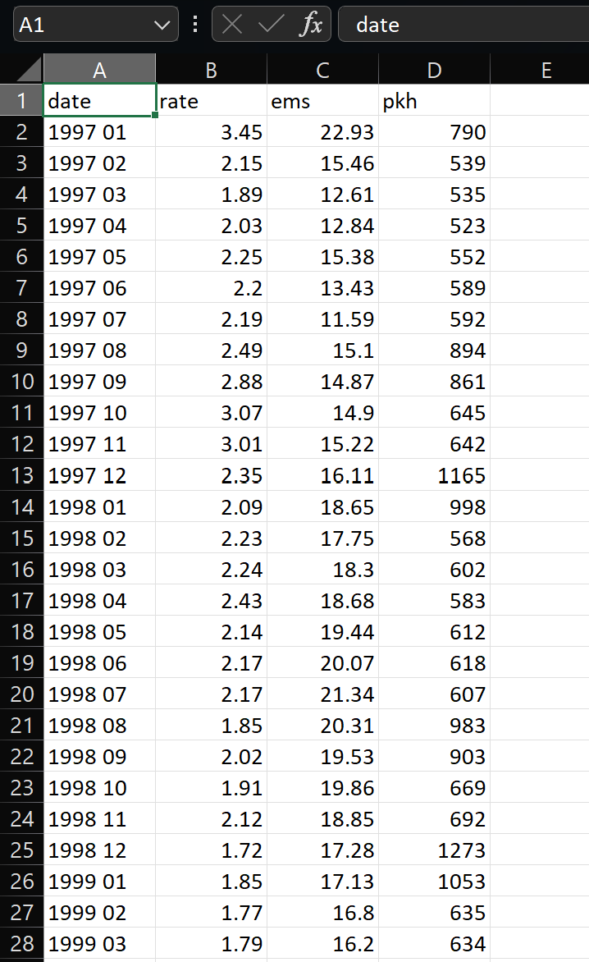
Introduction to dataset
It consists of 290 records, each corresponding to a month within the timeframe from 1997 to 2021.
Every individual record, which is represented as a row, comprises four distinct features: "date," "rate," "ems," and "pkh“.
These features provide information about the specific date of the month, the rate, the "ems" value, and the "pkh" value for that given time period.

Slide 3
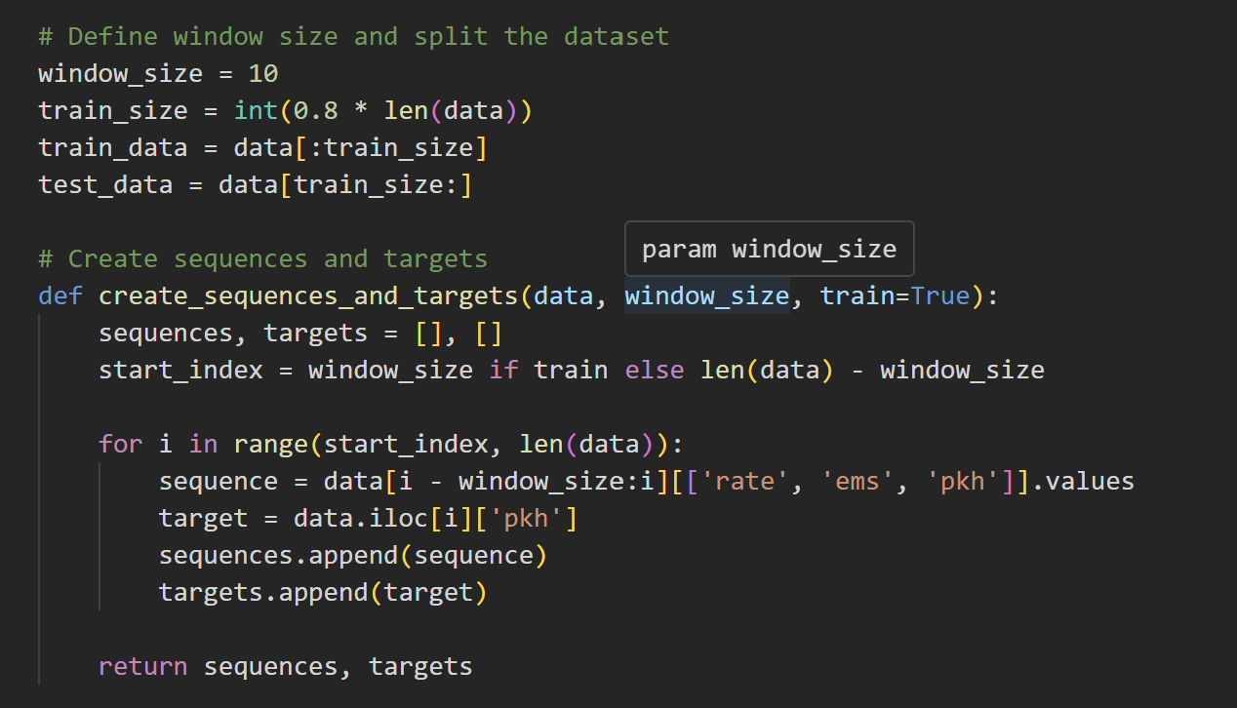
Implementing the sliding window

Slide 4
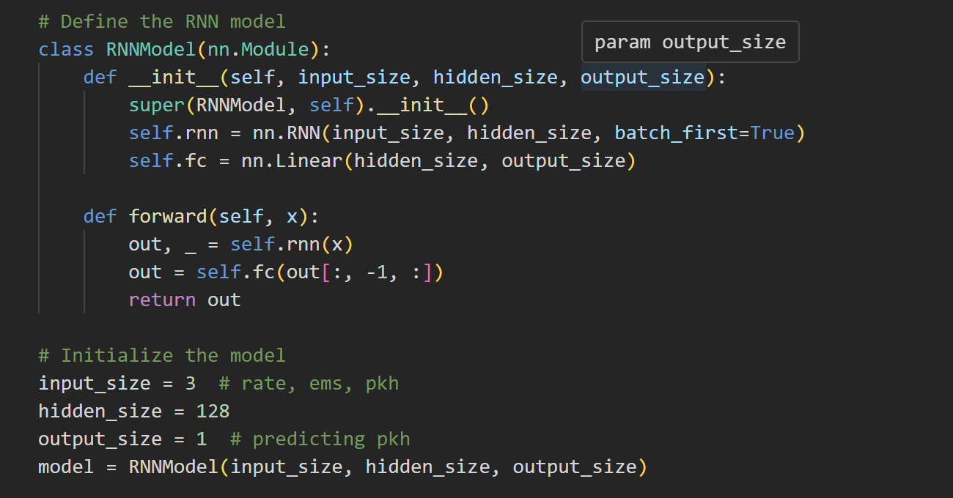
Overview of the models
Single Layer RNN

Slide 5
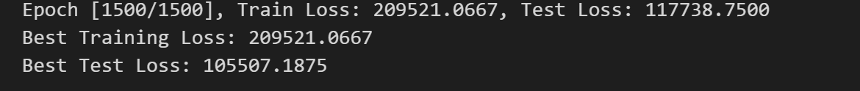
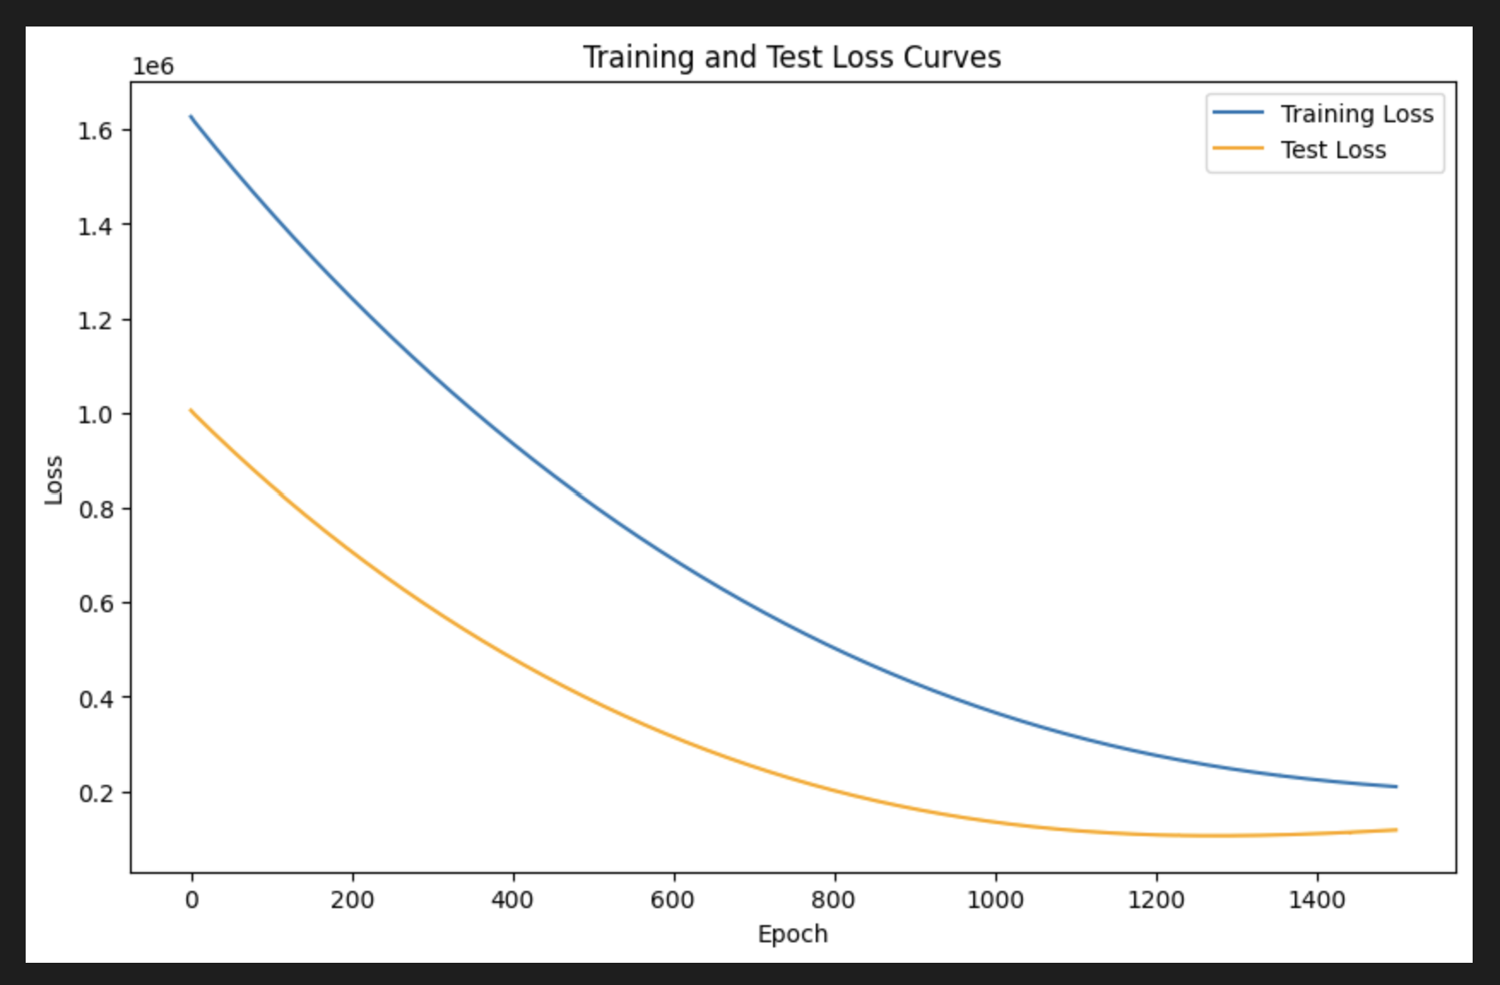
Output

Slide 6
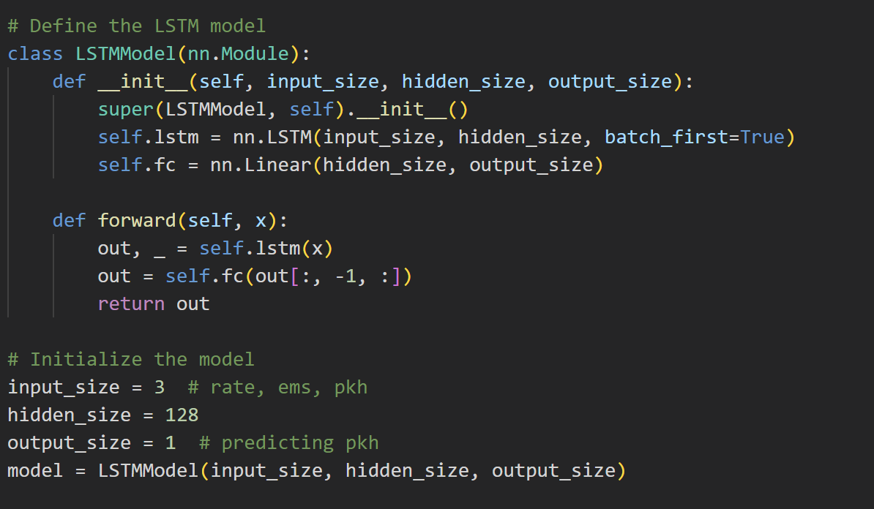
Single Layer LSTm

Slide 7
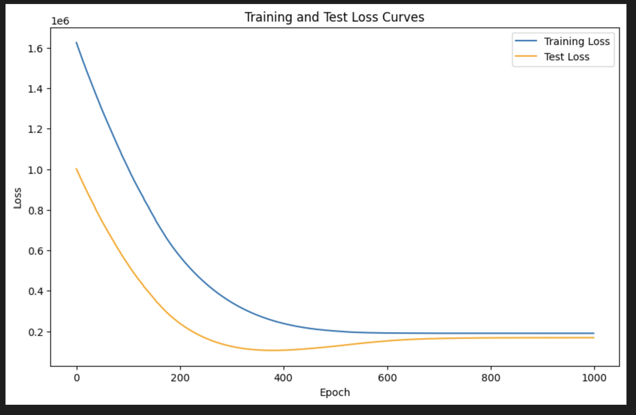
output

Slide 8
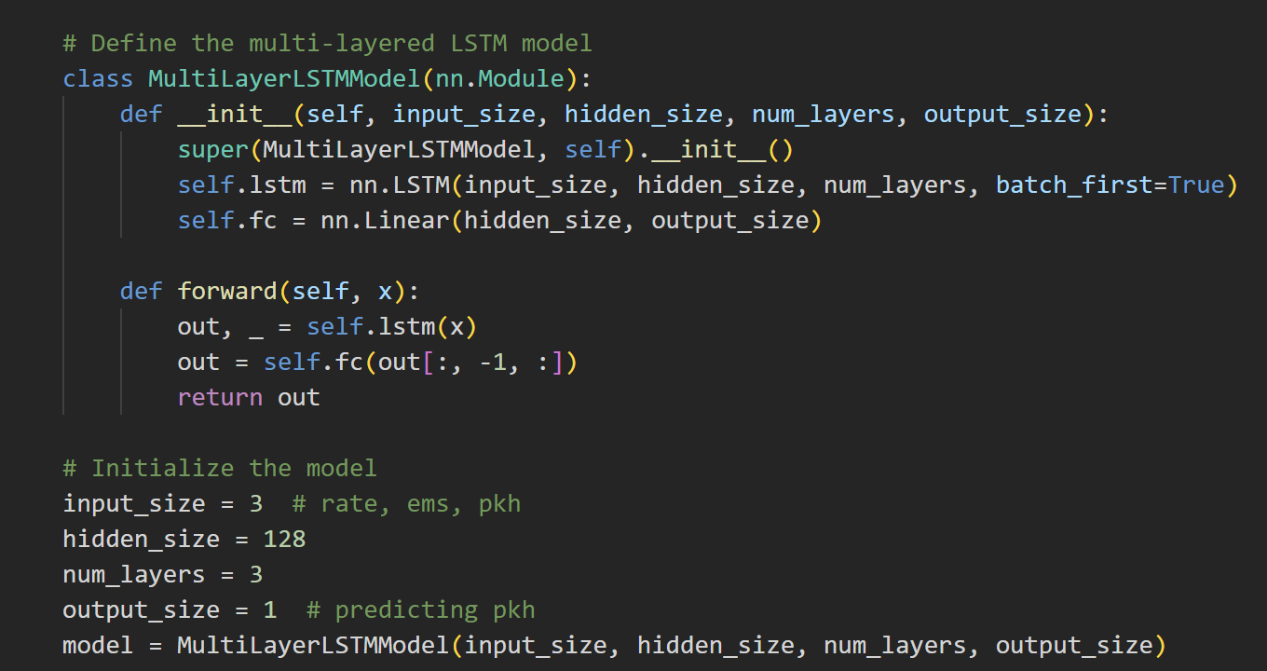
Multi layered lstm

Slide 9
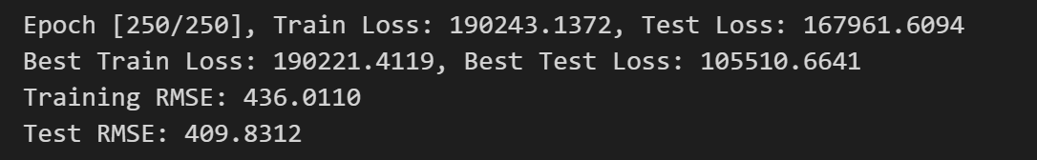
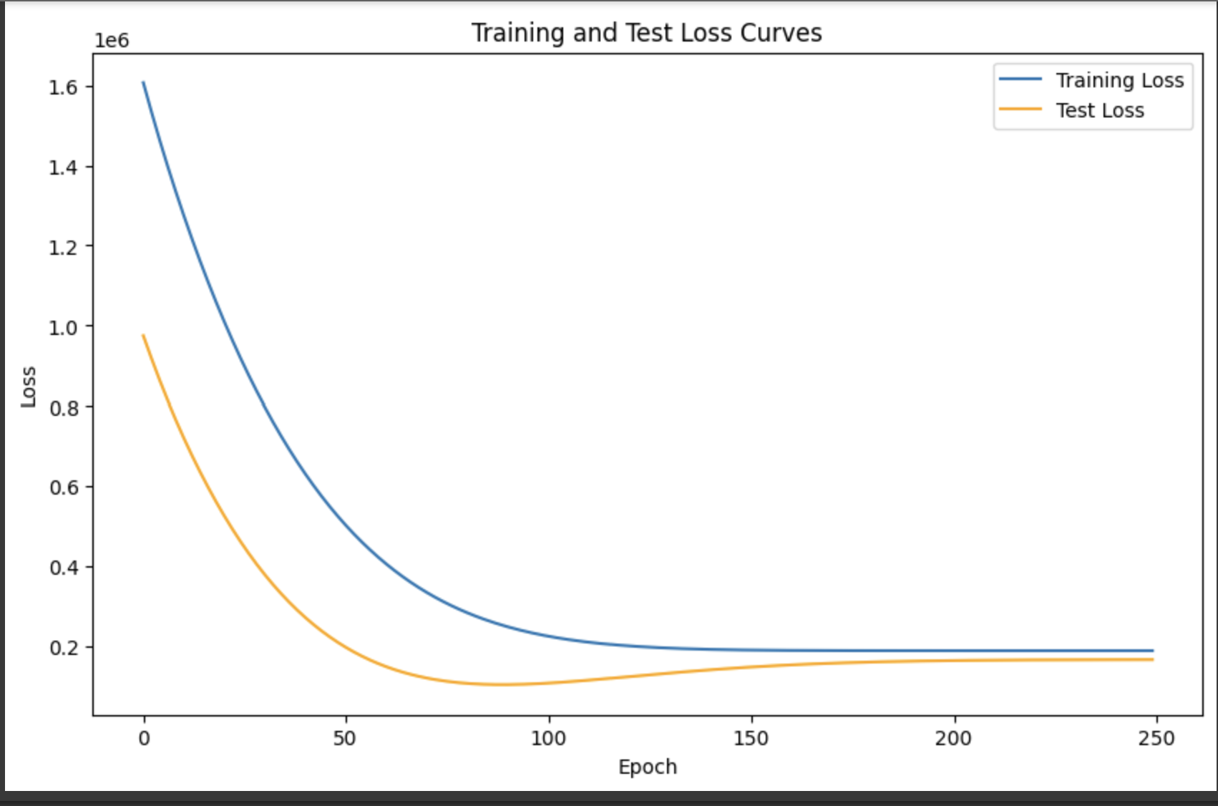
output

Slide 10
Hyperparameter tuning
Learning Rate
Learning rate determines the step size during optimization.
Higher Values: Faster convergence, but risk of overshooting optimal weights.
Lower Values: Slower convergence, but more stable learning process.
We experimented with different learning rates to find a balance between speed and stability.
Batch Size
Batch size specifies the number of training examples used in one iteration.
Larger Batches: Faster training but may lead to memory limitations.
Smaller Batches: More precise weight updates but slower training.
We optimized batch size to achieve both speed and accurate weight updates.

Slide 11
Hyperparameter tuning
Number of Hidden Units
Hidden units control the model's capacity to learn complex patterns.
Higher Units: More capacity to learn intricate patterns but risk of overfitting.
Lower Units: Simpler model with potential underfitting.
We adjusted the number of hidden units to find an optimal trade-off between model complexity and generalization.
Number of Layers
Number of layers influences the depth of our model.
More Layers: Increased capacity to capture intricate relationships but risk of vanishing/exploding gradients.
Fewer Layers: Simpler model but may struggle with complex data.
We experimented with different layer configurations to balance complexity and stability.

Slide 12
Analysis
Key Takeaways
Model Complexity Matters: Complex patterns require deep architectures like LSTMs.
Hyperparameters Influence Convergence: Optimizing them enhances training speed and final accuracy.
Trade-off Between Simplicity and Accuracy: RNNs may be simpler but may not capture intricate trends.
Iterative Process: Hyperparameter tuning requires experimentation and iteration.
Continuous Learning: Continuous monitoring and updates are essential for dynamic datasets.

